Slide 1

When Software Starts Talking to Itself
Adi Polak

Slide 2
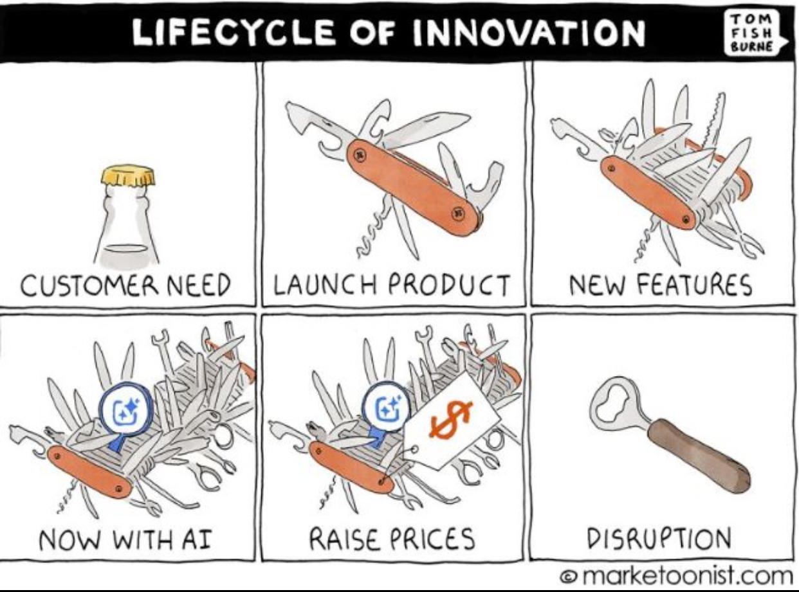
Notes:
We taught software how to talk. Now let’s teach it to keep its promises.

Slide 3

Notes:
Traveling from the Bay Area to the Netherlands is a beautiful experience—once you remove the part where your knees meet the seat in front of you. On my way here yesterday. I wanted to travel to the conference in comfort. There is a ritual on long-haul flights. Everyone wants the same upgrade. Everyone has a strategy. Refresh, negotiate, hope. My strategy this time was slightly different. I asked my bot to help.

Slide 4
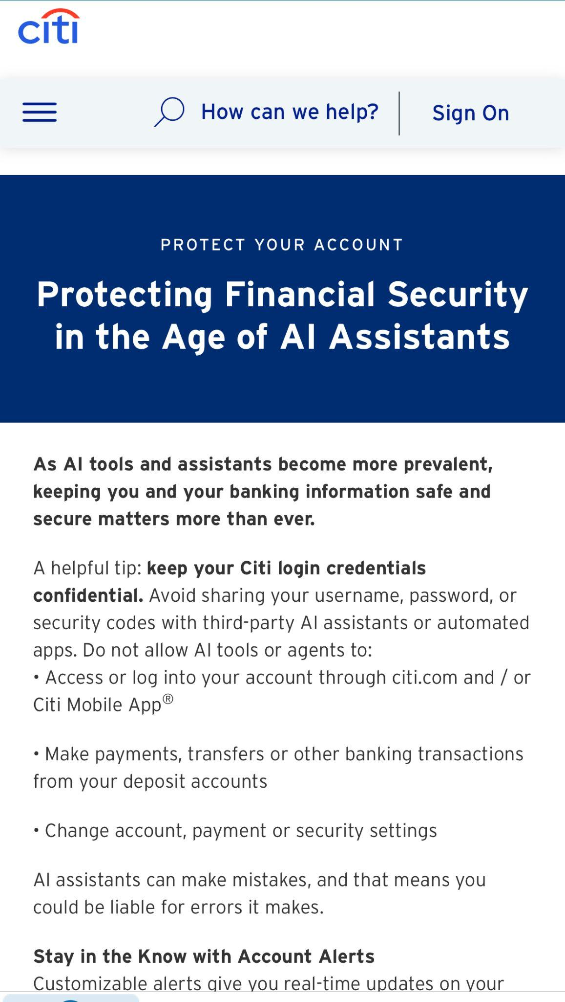

Slide 5
A DEMO THAT LOOKS LIKE MAGIC. UNTIL IT RETRIES.
ONE REQUEST
TWO SIDE EFFECTS
"Secure my upgrade."
Retry → two booking attempts
A broker can redeliver. Your agent must not re-purchase tickets.
Adi Polak
40
Notes:
. “My bot successfully helped with my upgrade. Here's the failure I do not want in production.” The instruction is retried. A worker restarts or a message is redelivered, and the agent no longer knows whether the external booking request succeeded. Two tool invocations may attempt the same upgrade. “A message acknowledgment cannot un-purchase a seat or un-send an email.” Keep stable external operation IDs, reconcile unknown outcomes, and enforce authorization before irreversible effects. Then move into four reliability questions.

Slide 6
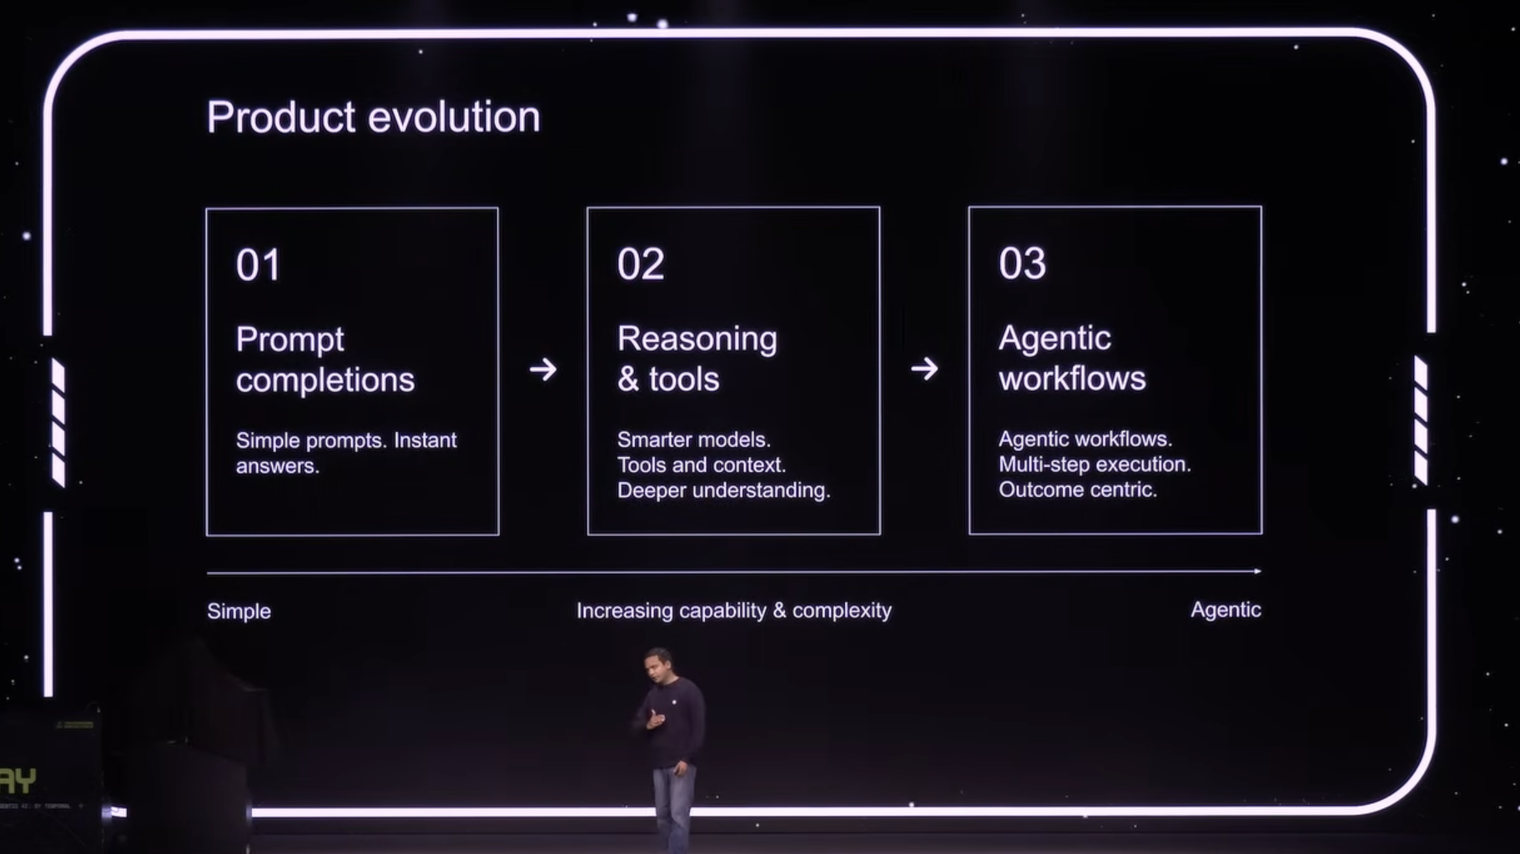
Notes:
Venkat Venkataramani
talks about openAI evoluation
sdlc, marketing, product research, customer success
our systems across the board are becoming more agentic
just last week Anthropic shared that their PR grew to 30k a month

Slide 7
AI AGENTS CAN
→ interpret events
→ make decisions
→ call tools
→ create new work
→ communicate with other agents
→ change behavior based on what they observe
Adi Polak
20
Notes:
Modern agents interpret events, choose tools, generate sub-tasks, communicate with other agents and inspect outcomes. That is already several external operations before the original message is complete.
Some agent systems are fixed chains with model calls; others are tool-use loops or dynamic planners. Their architectures might be different, yet the same distributed-systems questions follow them: ownership, ordering, budgets and effects

Slide 8


Slide 9
THE CONTRACT WE BUILT
A message gets delivered.
A consumer runs code.
But who chooses the next action?
Adi Polak
15
Notes:
Here is the canonical message processing path. We deliver an event; a consumer executes code. The delivery guarantees differ by product and configuration, but the abstraction is familiar. We can inspect the code, deploy it, measure it, and own its side effects.” This is not saying every consumer was deterministic; concurrency and I/O already complicate everything. It's that the possible branches were predominantly written down as code. The agent adds runtime-selected branches.”

Slide 10
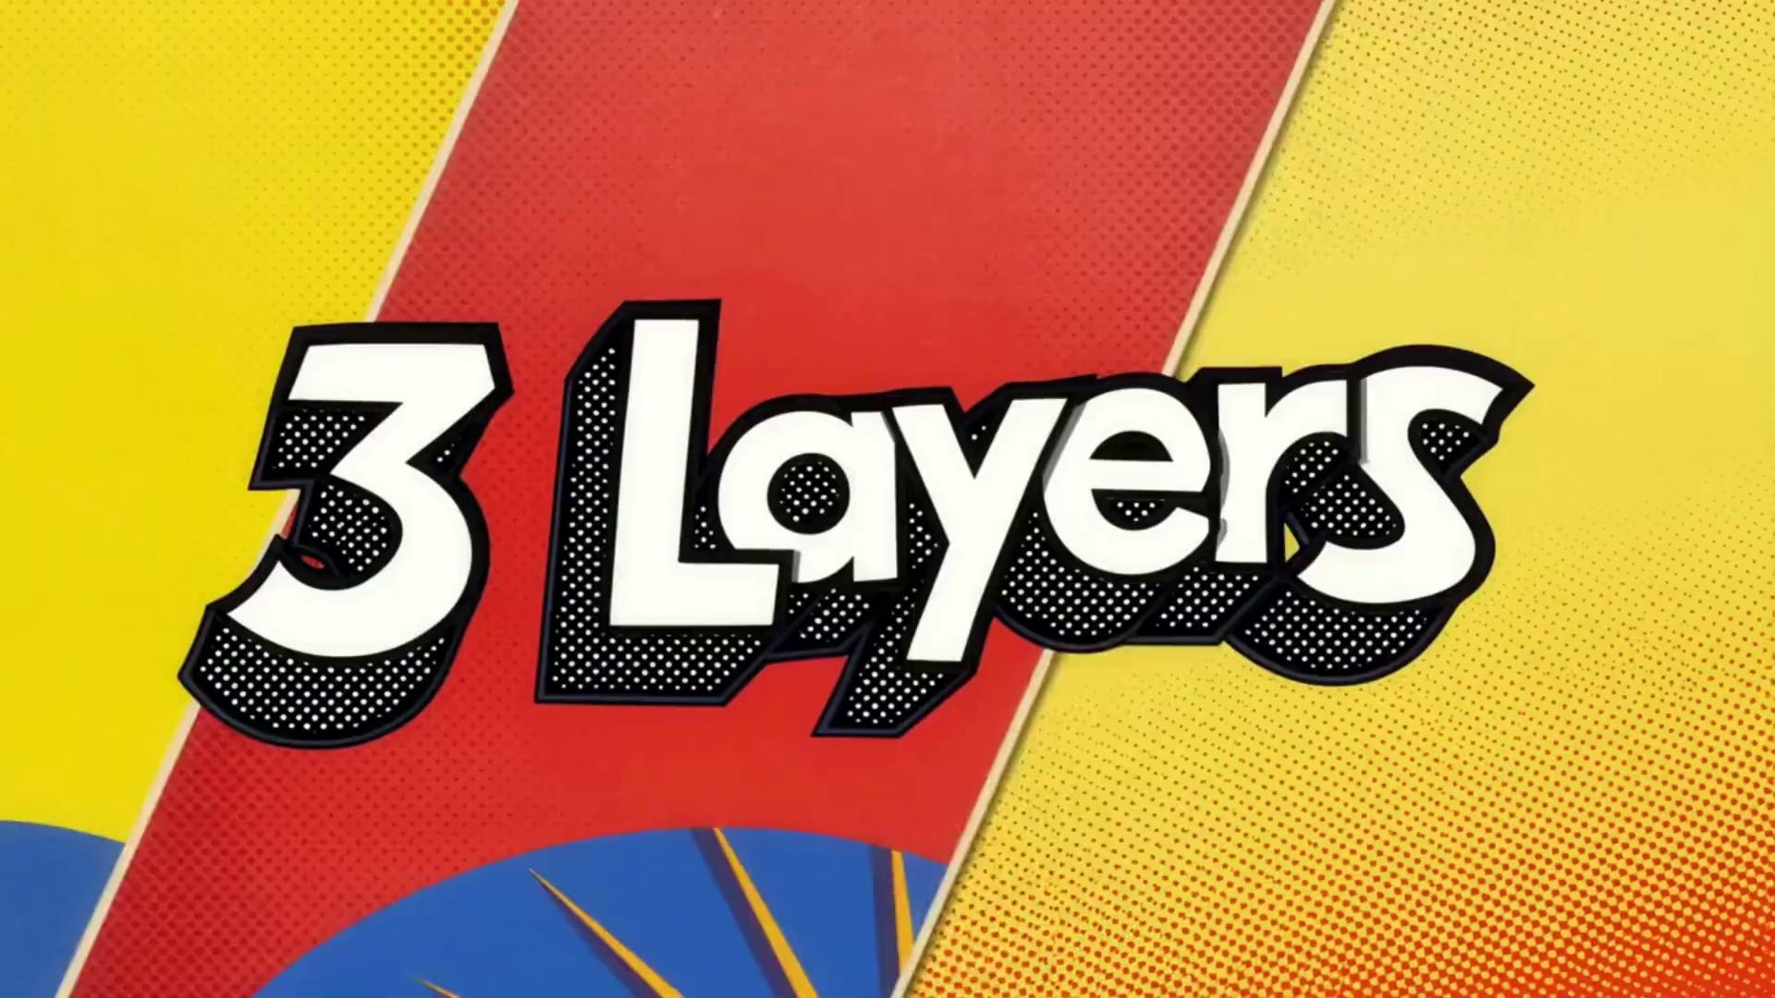

Slide 11
LAYER 1 / Humans talk to software
INTENT
INTERFACE
EXECUTION
Click
Type
API
"I want a result."
Run explicit logic
Human intent → software behavior → human observes the outcome
Adi Polak
8
Notes:
“Layer one is familiar: a human asks a computer to do something; a program executes the paths we built for it.” Think command lines, forms, and applications. Traditional software isn't necessarily simple or deterministic. The distinguishing feature here is who originates the task and who largely controls the goal. “The human is in the driver's seat. The software is extremely fast

Slide 12
LAYER 2 / Software talks to software
PRODUCER
BROKER
CONSUMER
Emits facts
Routes / stores
Acts on facts
Event streams · Work queues · Pub/sub · RPC / APIs
Adi Polak
9
Notes:
Layer two is this room's greatest accomplishment.We turned communication into durable infrastructure.
Systems no longer need a human to drive each step. They communicate through events, streams, queues and APIs. We engineered durable delivery, scoped ordering, retries, flow control and recovery.
Existing systems already make decisions according to coded rules;

Slide 13
LAYER 3 / Software starts talking to itself
OBSERVE
DECIDE
DELEGATE
ACT
The code defines the boundaries. The agent chooses the path.
Adi Polak
10
Notes:
Layer 3 is when software starts talking to itself. meaning the shift ahead is dynamically chosen task paths
this layer does not invent a new wire protocol.
It adds software that can choose among permitted paths at runtime. observe a new fact; propose a plan; select a specialist or tool; act; inspect the result; perhaps go again. A message used to invoke a known piece of behavior. Now it can invoke a decision-making loop. this is a nondeterministic and adaptive software inside guarded environment.
One event can create a new plan, new messages, and new side effects.
Not new transport. A new decision-maker at the edge of transport.

Slide 14
THREE LAYERS. ONE SYSTEM.
AGENT DECISIONS
03
Goals · planning · delegation · tools
DISTRIBUTED COMMUNICATION
02
Event streams · queues · durable messages
HUMAN INTENT & OVERSIGHT
01
Interfaces · approvals · policies
Adi Polak
11
Notes:
They accumulate; they do not replace each other.
The agent still needs transport. The transport still needs policies, users and a business goal. Think of it as three layers of control.
The human gives authority and intent. Middleware moves and persists facts. The agent runtime chooses and coordinates the next move.

Slide 15
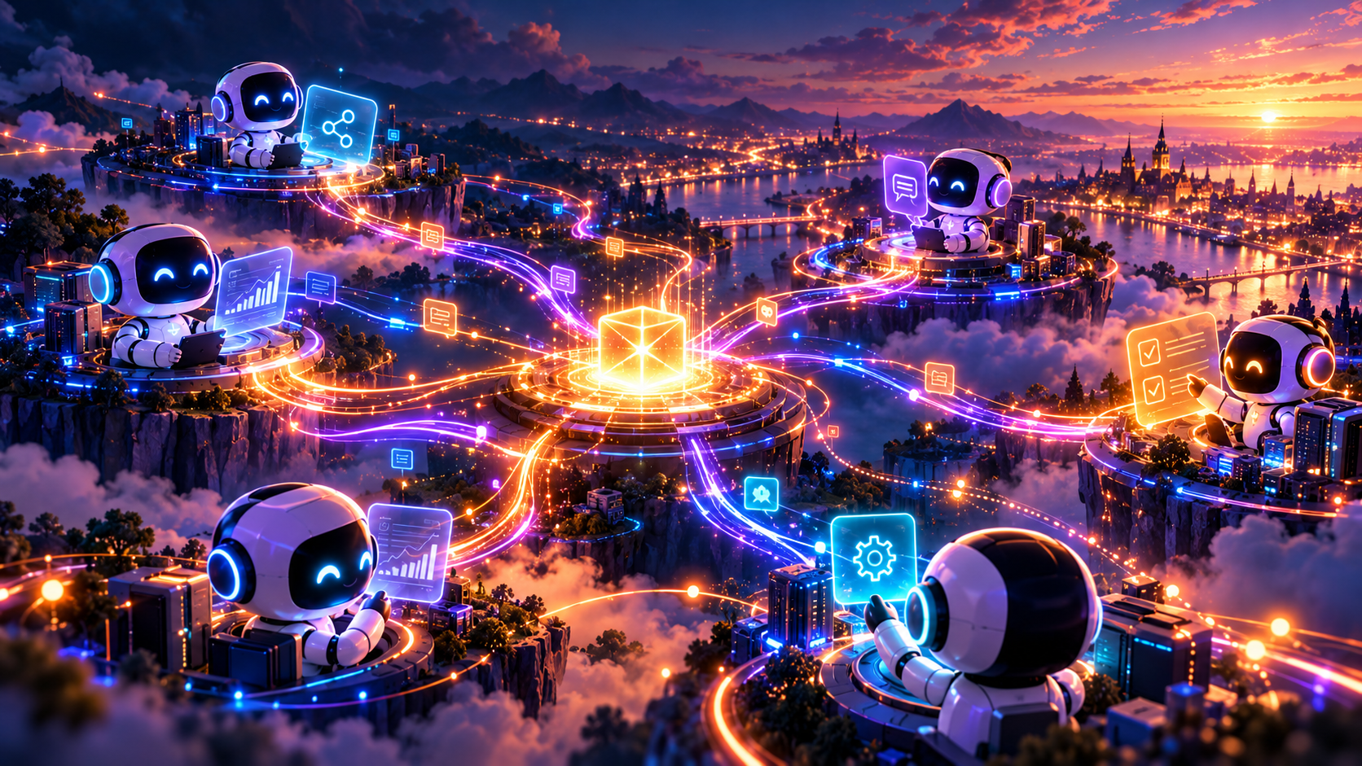
Notes:
Agents reason and delegate
Events connect their work.

Slide 16
So what is the unit of work, today?
Adi Polak
15

Slide 17
THE UNIT OF WORK
AN EVENT
A CONSUMER
PROCESSES IT
A RESULT
A message is a delivery unit. A task can be much larger.
Adi Polak
16
Notes:
A message is still a message: this is the unit the broker transports. The work performed in response may be much bigger.”
“In most broker architectures we can reason about each consumer and its bounds. With agents we must reason about a task that outlives one delivery.The difference is data-dependent planning and tool decisions at runtime.
Here is the canonical message processing path. We deliver an event; a consumer executes code. The delivery guarantees differ by product and configuration, but the abstraction is familiar. We can inspect the code, deploy it, measure it, and own its side effects.” This is not saying every consumer was deterministic; concurrency and I/O already complicate everything. It's that the possible branches were predominantly written down as code. The agent adds runtime-selected branches.”

Slide 18
THREE EXPECTATIONS WE COULD REASON ABOUT
EXPLICIT PATHS
MEASURABLE
SCOPED EFFECTS
The code defines
the branches.
Work can be
measured and capped.
Permissions govern
what it may touch.
Adi Polak
17
Notes:
These are not assumptions the broker guarantees. This is what engineers try to establish at the application boundary: code-reviewable paths, measurable limits and scoped effects. An LLM in a tool loop forces us to make those contracts explicit and enforce them outside the model. “When I debug an ordinary service, I can inspect the branch conditions. When I debug an agent, I also need to know what context, model, tools and observations shaped the branch.”

Slide 19
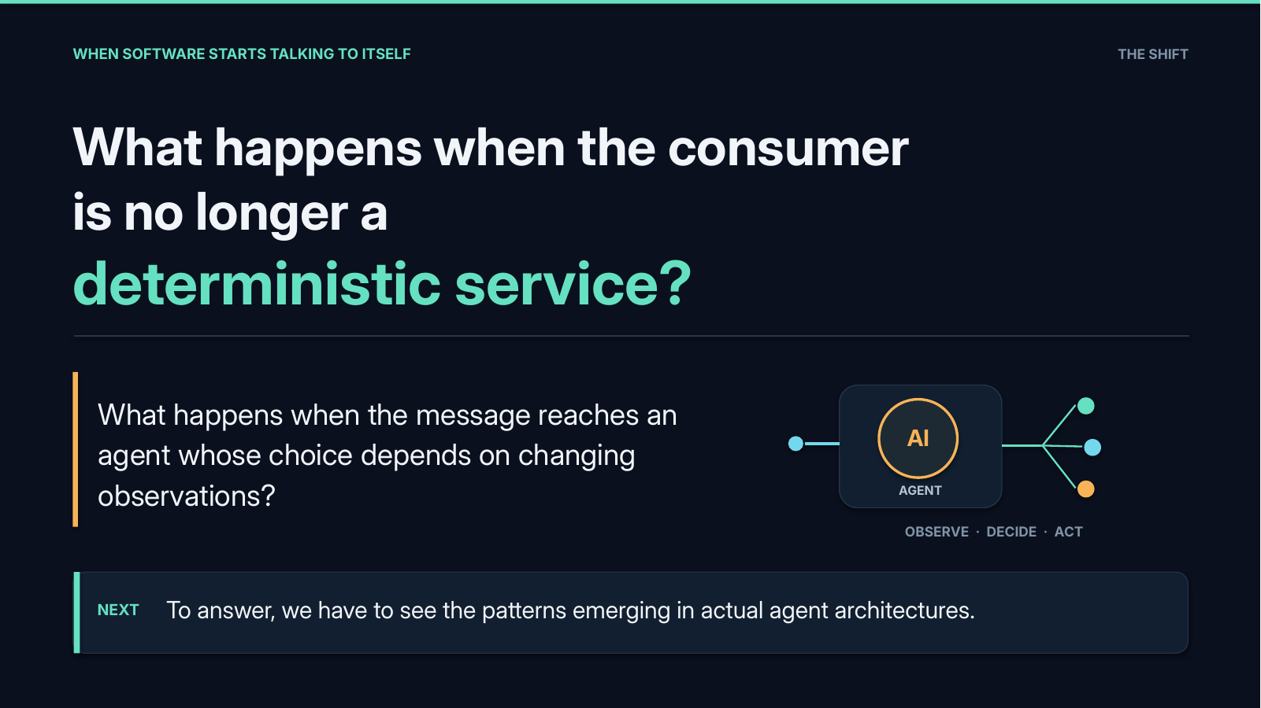
Notes:
What happens when the consumer is no longer a deterministic service?”
What happens when the message reaches an agent whose choice depends on changing observations?
To answer, we have to see the patterns emerging in actual agent architectures.”

Slide 20

Notes:
One event. A conversation begins. Agents respond, delegate, and create new work

Slide 21
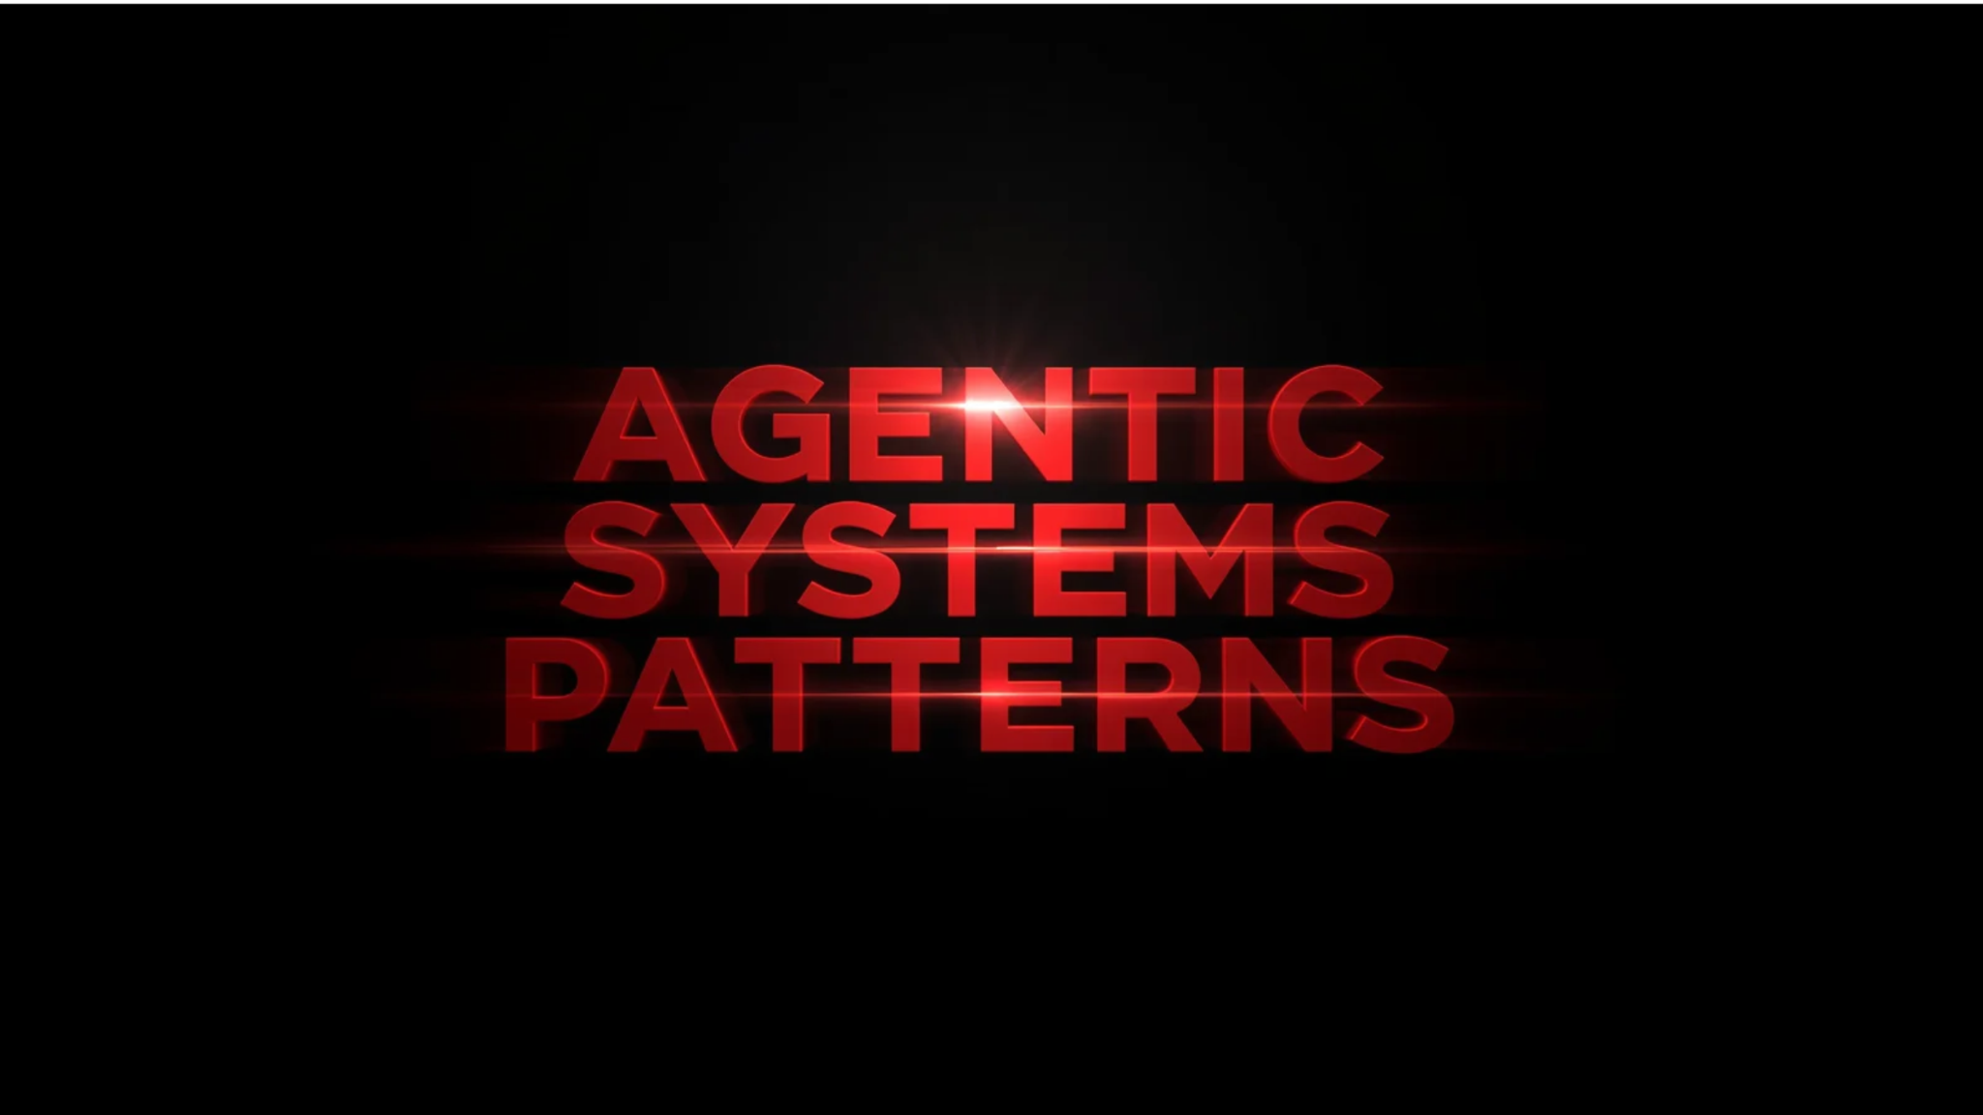
Notes:
event drive agentic patterns

Slide 22
AGENTIC SYSTEM PATTERNS
PATTERN 01 / The tool-use loop
AGENT
TOOL / API
EVENT
Plan → choose tool
OBSERVATION
Adi Polak
22
Notes:
Start with one tool-using agent. Event in; it picks a tool; the result becomes its next observation. A single agent can already create multiple external effects.

Slide 23
RELIABILITY QUESTION:
How do you bound iterations
and authorize the next tool call?

Slide 24
AGENTIC SYSTEMS / TOOLS
PATTERN 01 - agent call APIs
A flight-upgrade agent can observe the world and take real actions.
01
READ
02
READ
03
READ
Flight search
Preferences DB
Calendar API
search_available_upgrades()
get_traveler_preferences()
check_calendar()
Find available seats
Check passenger preferences
Check schedule conflicts
04
WRITE
05
WRITE
06
WRITE
Booking API
Payment API
Email API
upgrade_seat()
charge_card()
send_confirmation()
Reserve a new seat
Process payment
Notify the passenger
THE IMPORTANT DISTINCTION
A search reads state. A booking or charge creates an external side effect.
WHEN SOFTWARE STARTS TALKING TO ITSELF
Notes:
The essential distinction is that the next branch is selected at runtime.

Slide 25
AGENTIC SYSTEMS / TOOL CALLS
PATTERN 01 -One request. Multiple decisions. Multiple tool calls.
The agent selects what to invoke, in what order, and whether to try again.
OBSERVE
1
Flight search
search_available_upgrades()
INCOMING MESSAGE
Read live availability
“Upgrade me to business class.”
AI AGENT
ACT
2
Booking API
upgrade_seat()
Chooses the next call
Reserve an upgrade
ACT
NOT A FIXED PIPELINE
3
Payment API
charge_card()
The agent can search again, branch, delegate, or retry.
Charge the passenger
THE DISTRIBUTED-SYSTEMS PROBLEM
Retries after timeouts can repeat bookings or payments.
WHEN SOFTWARE STARTS TALKING TO ITSELF
Notes:
RELIABILITY QUESTION How do you bound iterations and authorize the next tool call?
Limit iterations, tool permissions, wall-clock time and cost. Trace tool outcomes to one task ID.

Slide 26
AGENTIC SYSTEM PATTERNS
PATTERN 02 / Sequential chain
RELIABILITY QUESTION
what if the intermediate errors propagate as plausible-looking decisions
EXTRACT
DECIDE
DRAFT
Agent A
Agent B
Agent C
LAYER 2 ANCESTOR Pipes & filters, workflow stages, durable step transitions.
A workflow chooses the order; each agent owns a step.
Adi Polak
23
Notes:
The fixed chain is our familiar pipeline: extract, decide, draft. Each agent has a clear contract and handoff.
Reliability question?
The AI twist is that intermediate errors propagate as plausible-looking decisions.
Validate every step and checkpoint durable state. If the steps are predictable, use an ordinary workflow rather than asking an agent to invent the flow.

Slide 27
AGENTIC SYSTEM PATTERNS
PATTERN 02 / Sequential chain
RELIABILITY QUESTION
What happens when intermediate errors propagate as plausible-looking decisions?
EXTRACT
DECIDE
DRAFT
Agent A
Agent B
Agent C
LAYER 2 ANCESTOR Pipes & filters, workflow stages, durable step transitions.
A workflow chooses the order; each agent owns a step.
Adi Polak
23
Notes:
The fixed chain is our familiar pipeline: extract, decide, draft. Each agent has a clear contract and handoff. The AI twist is that intermediate errors propagate as plausible-looking decisions.
Validate every step and checkpoint durable state. If the steps are predictable, use an ordinary workflow rather than asking an agent to invent the flow. Source: https://learn.microsoft.com/en-us/azure/architecture/ai-ml/guide/ai-agent-design-patterns

Slide 28
AGENTIC SYSTEM PATTERNS
PATTERN 03 / Router + handoff
RELIABILITY QUESTION
BILLING AGENT
TASK
ROUTER
TRAVEL AGENT
HUMAN ESCALATION
Adi Polak
24
Notes:
A router or handoff agent picks the next specialist from context. That raises an old messaging question: who owns the message now? Use a stable task ID, explicit transfer, deadline, hop limit and escalation path. If two agents act concurrently, that must be intentional—not a duplicate handoff. Source: https://learn.microsoft.com/en-us/azure/architecture/ai-ml/guide/ai-agent-design-patterns

Slide 29
AGENTIC SYSTEM PATTERNS
PATTERN 03 / Router + handoff
RELIABILITY QUESTION
Who owns the task after a handoff? Who retries?
BILLING AGENT
TASK
ROUTER
TRAVEL AGENT
HUMAN ESCALATION
The next consumer is selected from the task context.
Adi Polak
24
Notes:
A router or handoff agent picks the next specialist from context. That raises an old messaging question: who owns the message now? Use a stable task ID, explicit transfer, deadline, hop limit and escalation path. If two agents act concurrently, that must be intentional—not a duplicate handoff. Source: https://learn.microsoft.com/en-us/azure/architecture/ai-ml/guide/ai-agent-design-patterns

Slide 30
AGENTIC SYSTEM PATTERNS
PATTERN 04 / Fan-out + fan-in
RELIABILITY QUESTION
New pain: conflicting answers.
ANALYZE
TRIGGER
SEARCH
JOIN / DECIDE
VERIFY
Layer 2 ancestor: pub/sub fan-out, scatter/gather.
Adi Polak
25
Notes:
“The message still travels. The TASK now branches.” One event can lead to zero or many sub-events and effects regardless of the underlying messaging system. Fan-out and fan-in aren't new; what's changing is that the task graph can be chosen dynamically at runtime. Track task status separately from delivery status, with correlation IDs, parent/child edges and action IDs. “The messaging system can tell you what was delivered; your product must tell you whether the mission succeeded.”
Parallel agents can inspect the same event from different perspectives and report back to an aggregator. That is scatter-gather with probabilistic conclusions. Arrival is not correctness. Require deadlines for stragglers, a correlation key and a conflict rule. More agents can mean more opinions, not more truth. Source: https://www.anthropic.com/engineering/building-effective-agents

Slide 31
AGENTIC SYSTEM PATTERNS
PATTERN 04 / Fan-out + fan-in
ANALYZE
TRIGGER
SEARCH
JOIN / DECIDE
VERIFY
Layer 2 ancestor: pub/sub fan-out, scatter/gather.
Parallelism buys time, then creates a consistency problem.
Adi Polak
25
Notes:
“The message still travels. The TASK now branches.” One event can lead to zero or many sub-events and effects regardless of the underlying messaging system. Fan-out and fan-in aren't new; what's changing is that the task graph can be chosen dynamically at runtime. Track task status separately from delivery status, with correlation IDs, parent/child edges and action IDs. “The messaging system can tell you what was delivered; your product must tell you whether the mission succeeded.”
Parallel agents can inspect the same event from different perspectives and report back to an aggregator. That is scatter-gather with probabilistic conclusions. Arrival is not correctness. Require deadlines for stragglers, a correlation key and a conflict rule. More agents can mean more opinions, not more truth. Source: https://www.anthropic.com/engineering/building-effective-agents

Slide 32
AGENTIC SYSTEM PATTERNS
PATTERN 05 / Orchestrator + workers
WORKER A
ORCHESTRATOR
Plan · delegate
observe · replan
WORKER B
WORKER C
The task graph is discovered while the system is running.
Adi Polak
26
Notes:
SLIDE 26 · 19:50–20:40 · 0.833333 min
SECTION: orchestrator
An orchestrator discovers tasks while it works: plan, delegate, observe, replan. This differs from fixed fan-out because the graph itself changes. Budget hops, tokens, tool calls and concurrent subtasks. Record task state so a restart does not invent new history. In a moment we will contrast this centralized pattern with event choreography. Source: https://www.anthropic.com/engineering/building-effective-agents

Slide 33
AGENTIC SYSTEM PATTERNS
PATTERN 05 / Orchestrator + workers
RELIABILITY QUESTION
How do we cap work that did
not exist in the original plan?
WORKER A
ORCHESTRATOR
Plan · delegate
observe · replan
WORKER B
WORKER C
The task graph is discovered while the system is running.
Adi Polak
26
Notes:
An orchestrator discovers tasks while it works: plan, delegate, observe, replan. This differs from fixed fan-out because the graph itself changes. Budget hops, tokens, tool calls and concurrent subtasks. Record task state so a restart does not invent new history. In a moment we will contrast this centralized pattern with event choreography.

Slide 34
AGENTIC SYSTEM PATTERNS
PATTERN 06 / Evaluate, retry, escalate
DRAFT
EVALUATE
COMMIT
FAIL / FEEDBACK
Adi Polak
27
Notes:
SLIDE 27 · 20:40–21:20 · 0.666667 min
SECTION: critic
In a reflection loop, an evaluator critiques an output and a worker revises it. Useful when quality can be measured; risky when the finish line is vague. Set acceptance criteria and a maximum number of cycles. For real-world actions, evaluation is not authorization: a separate policy gate controls the commit. So far these are patterns *inside tasks*. Now let us connect agents with events *across tasks*.

Slide 35
AGENTIC SYSTEM PATTERNS
PATTERN 06 / Evaluate, retry, escalate
DRAFT
EVALUATE
COMMIT
FAIL / FEEDBACK
???
Max iterations · acceptance criteria · human approval for irreversible actions
A feedback loop needs a stopping condition.
Adi Polak
27
Notes:
SLIDE 27 · 20:40–21:20 · 0.666667 min
SECTION: critic
In a reflection loop, an evaluator critiques an output and a worker revises it. Useful when quality can be measured; risky when the finish line is vague. Set acceptance criteria and a maximum number of cycles. For real-world actions, evaluation is not authorization: a separate policy gate controls the commit. So far these are patterns *inside tasks*. Now let us connect agents with events *across tasks*.

Slide 36
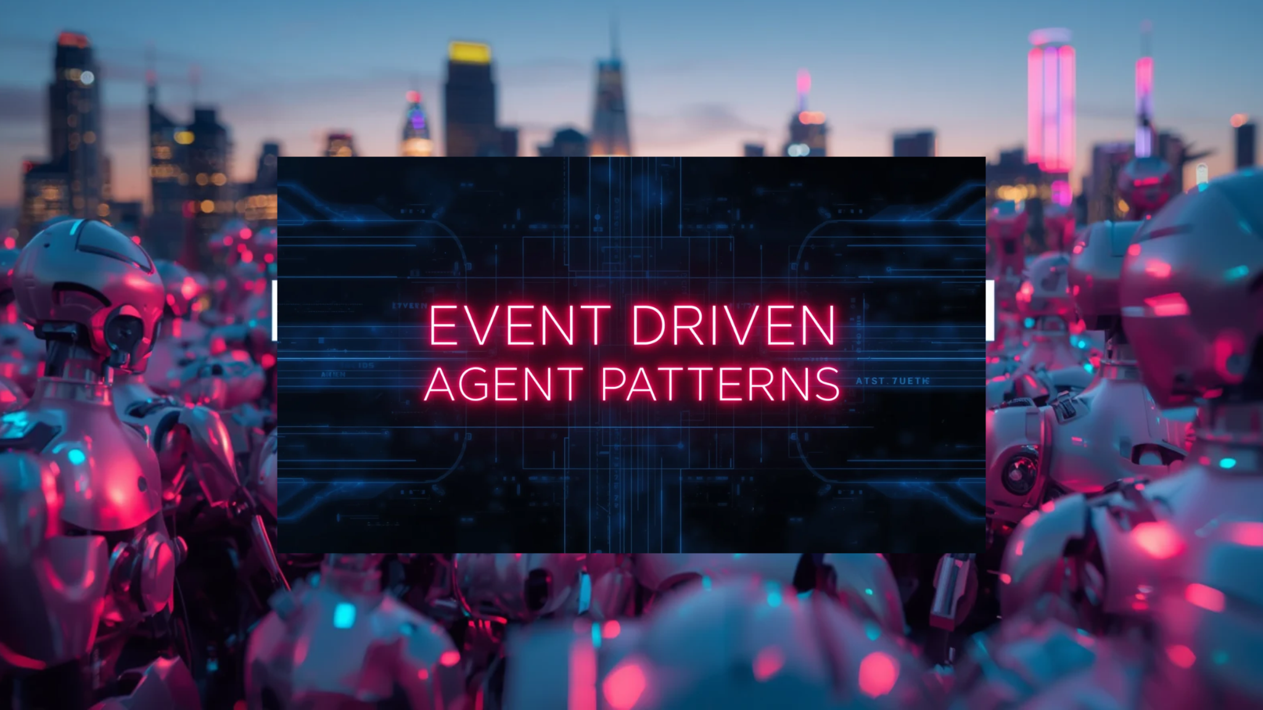
Notes:
SLIDE 28 · 21:20–21:30 · 0.1667 min
SECTION: CINEMATIC VISUAL
VISUAL BREATH — 10 seconds. Hold the image for one sentence. Cinematic illustration; use this to let the previous technical concept land.
KEY IDEA: No conductor. A shared rhythm. Independent agents, connected through events
VISUAL VERSION — on-slide text moved off the image:
• AGENT CHOREOGRAPHY
• No conductor.
• A shared rhythm.
• Independent agents, connected through events
• Adi Polak
• 28

Slide 37
EVENT-DRIVEN AGENT PATTERNS
PATTERN 07 / Reactive agent consumer
Events become observations. Decisions become commands or new events.
BUSINESS
EVENT
EVENT
BACKBONE
AGENT
COMMAND /
NEW EVENT
An agent is an event consumer - - - but its next action is selected at runtime.
QUESTION Which events deserve reasoning—and who is authorized to act?
Adi Polak
29
Notes:
A classic event-driven system already reacts to events.
The event is deterministic. The agent's next action is selected at runtime.
And your closing question becomes:
Who authorized the agent to spend $300 on an upgrade—and what happens if it processes the event twice?
Here the consumer gains a bounded decision loop. a customer request emits an event; an agent retrieves relevant context and proposes what to do; the system publishes a command or a new fact. The trigger is NOT a license to act. Filter events, cap costs, and put identity and policy at the action boundary. Distinguish facts from commands. This is agentic decisioning layered on proven messaging, not a new broker.
Source: https://docs.aws.amazon.com/prescriptive-guidance/latest/agentic-ai-serverless/event-driven-architecture.html

Slide 38
EVENT-DRIVEN AGENT PATTERNS
PATTERN 08 / Agent choreography
No central manager. Specialized agents react to each other’s events.
OBSERVE
INVESTIGATE
RESPOND
SHARED EVENT CHANNEL • typed facts + correlation IDs
Signal detected
Finding ready
Action proposed
Each agent owns its capability; nobody owns the whole story by default.
RELIABILITY QUESTION What stops an event storm or cyclic delegation?
Adi Polak
30
Notes:
This is the biggest architectural shift for a messaging. Instead of one supervisor calling workers, an observer agent publishes Detected Signal; an investigator subscribes and publishes Finding are Reeady; a response agent may publish Proposed Action. The agents can be deployed and scaled independently, and the event channel connects them. But nobody automatically owns the end-to-end outcome. Cycles, duplicate reactions, schema drift and emergent event storms are familiar hazards, amplified by runtime-generated decisions.
Use typed event contracts, causation and correlation IDs, allowed transitions, hop limits and an outcome owner. Compare with the preceding orchestrator slide: centralized task control versus event choreography.

Slide 39
EVENT-DRIVEN AGENT PATTERNS
PATTERN 09 / Streaming context
The agent reasons over live state—not just the last message it received.
CDC
TELEMETRY
USER EVENTS
LIVE STATE
AGENT
Materialized context
Grounded decision
Events → stateful processing → fresh context → decisions
KEY DISTINCTION A durable log is history. A stateful projection is current context.
Adi Polak
31
Notes:
SLIDE 31 · 23:30–24:30 · 1 min
SECTION: streaming
This is where stream processing becomes genuinely new infrastructure for agents. A single message may not include the whole world: inventory changed in one system, payment status in another, telemetry arrives continuously. Change streams and signals feed stateful processing, maintaining a compact live view. The agent asks that view for relevant context instead of rebuilding the past from raw events or relying on stale chat memory. Crucial distinction: event history and materialized context serve different jobs. Add freshness metadata, source provenance and access controls; before an irreversible effect, validate current state again. This is a proposed architectural pattern, not a claim that every agent platform does this already. Sources: https://materialize.com/events/webinar-real-world-context-engineering-ai-agents-enterprise/ ; https://docs.aws.amazon.com/prescriptive-guidance/latest/agentic-ai-serverless/orchestration-models.html

Slide 40
EVENT-DRIVEN AGENT PATTERNS
PATTERN 10 / Durable, event-waiting agents
A task can pause for hours, survive a crash, and resume on a new event.
START TASK
WAIT / SLEEP
EVENT ARRIVES
RESUME
CHECKPOINTED
An agent is not a process that must stay awake.
RELIABILITY QUESTION Who owns the wait, timeout, dedupe and cancellation?
Adi Polak
32
Notes:
A flight upgrade, vendor approval or incident remediation can take hours—or days. We should not keep a model loop alive while waiting. Instead, persist task state, wait durably for a message or a human signal, then resume with the same task and known history. This is the actor or entity-workflow shape applied to agents: a logical long-lived task with an event-driven lifecycle. Model and tool operations run as recorded activities, not unsafely re-executed during deterministic workflow recovery. Bound the wait with deadlines, cancellations, deduplication and timeouts. Relate it directly to the upgrade story without claiming the bot used this implementation

Slide 41
EVENT-DRIVEN AGENT PATTERNS
PATTERN 11 / Asynchronous agent delegation
Agent-to-agent exchange is a task lifecycle.
AGENT A
TASK #1842
AGENT B
Delegates
accepted → working → completed
Specialist
A2A-style task semantics complement durable messaging; neither replaces the other.
DESIGN CONTRACT Task ID · owner · progress · deadline · completion event
Adi Polak
33
Notes:
Imagine the travel agent delegates an eligibility check to an independent airline-support agent. One task can be accepted, remain working, wait for input, and complete asynchronously. The caller needs a stable task ID, ownership, timeout, progress, security context and a final artifact or event. Agent-to-agent protocols such as A2A describe capability discovery, task states, streaming updates and notifications. They are an interaction contract, not a substitute for your event backbone's durability guarantees. Don't claim that A2A itself provides append-only log storage or queue semantics. The emerging architecture separates semantic task collaboration from reliable internal event transport.

Slide 42
EVENT-DRIVEN AGENT PATTERNS
PATTERN 12 / Agentic saga
Autonomy crosses systems. Business actions do not share one transaction.
RESERVE
AUTHORIZE
CONFIRM
DONE
ON FAILURE: RELEASE HOLD • COMPENSATE • ESCALATE
A model proposes; policy and application logic commit.
RELIABILITY QUESTION What can be safely reversed? and what cannot?
Adi Polak
34
Notes:
An agent may initiate a multi-step business process: reserve inventory, obtain approval, charge a card, notify the user. There is no global ACID transaction across those systems. The saga pattern becomes especially important when the execution path is selected dynamically. Record a stable operation ID for every real-world effect, require policy and idempotency at commit, and define compensating actions for reversible steps. Compensation is NOT a true rollback: an email cannot be unsent, and a refund may not undo consequences. The model may recommend next steps, but deterministic control owns effect authorization, recovery and escalation.;

Slide 43
EVENT-DRIVEN AGENT PATTERNS
PATTERN 13 / Closed-loop autonomous control
Agents can react to the outcomes of their own previous actions.
SIGNAL
AGENT
POLICY GATE
ACTION
OUTCOME EVENT / OBSERVE AGAIN
THE DANGER Need a damping and a kill switch, without it the feedback loop is unpredictable
Adi Polak
35
Notes:
A monitoring signal triggers an agent, the agent proposes an operational change, a policy gate authorizes it, and the real system emits an outcome event. That event becomes the next observation. Systems already have control loops; the emerging twist is putting model-selected actions inside them. Make the control loop stable: deduplicate signals, apply cooldowns and hysteresis, cap change rates and budgets, log cause/effect, require human approval for high-impact changes, and build the kill switch first. Otherwise two well-meaning autonomous agents can repeatedly undo each other's repairs. Source:

Slide 44
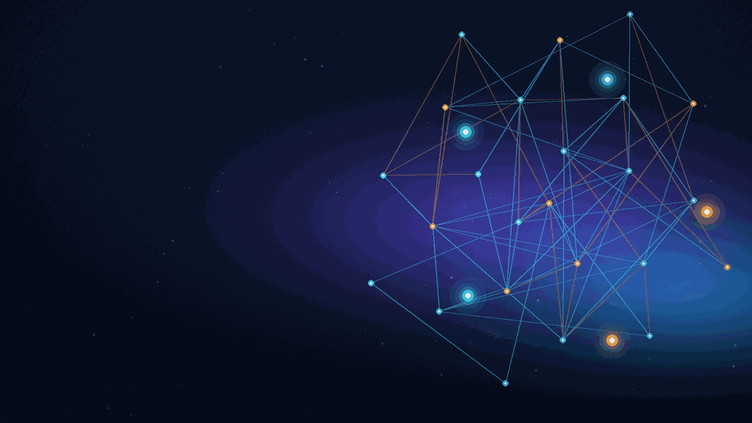
Can the System
handle this?
Notes:
SLIDE 36 · 28:20–28:30 · 0.1667 min
SECTION: CINEMATIC VISUAL
VISUAL BREATH — 10 seconds. Hold the image for one sentence. Animation: flowing signals represent event-driven task propagation; the motion is illustrative, not a product demo.
KEY IDEA: A system hears its own echoes. Action → outcome → observation → new decision
VISUAL VERSION — on-slide text moved off the image:
• CLOSED-LOOP CONTROL
• A system hears
• its own echoes.
• Action → outcome → observation → new decision
• Adi Polak
• 36

Slide 45
MESSAGING SYSTEMS / AGENTIC WORKFLOWS
What changes when the consumer is an agent?
The infrastructure is familiar. The failure modes are not.
FOUNDATIONAL GUARANTEE
WHAT CHANGES WITH AGENTS
THE FLIGHT UPGRADE BOT
01
ORDERING
Events arrive in order, but decisions also depend on external observations.
Seat available when checked, gone before the bot books.
02
EXACTLY-ONCE
Processing guarantees don’t automatically cover external business actions.
Booking succeeds → timeout → retry risks a second upgrade.
03
BACKPRESSURE
One message can spawn an expanding graph of tool calls, tasks, and retries.
One request fans out into searches, checks, and delegated work.
04
REPLAY
The same input may produce different decisions,or repeat side effects.
A replay must not trigger another purchase or booking.
THE SHIFT
Reliable message delivery no longer guarantees reliable outcomes.

Slide 46
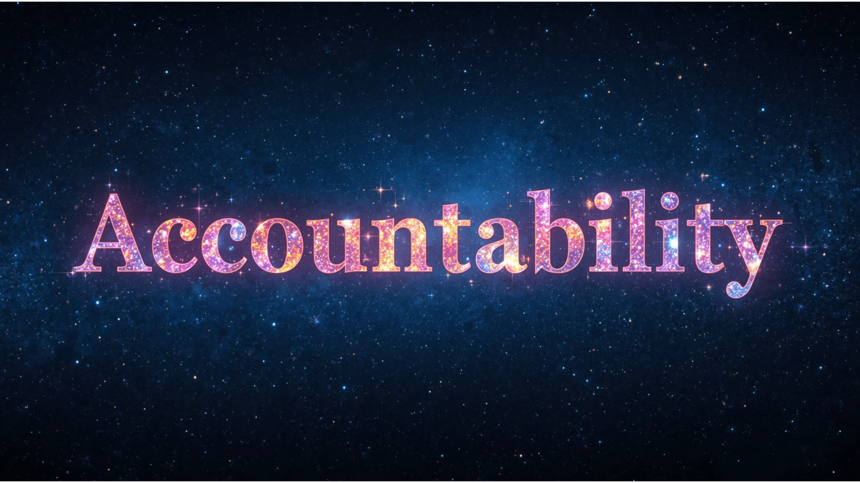
Notes:
• One message.
• Many consequences.
• Reliability lives beyond delivery.

Slide 47
THE TASK IS THE UNIT OF ACCOUNTABILITY
OBSERVE
DECIDE
ACT
CONFIRM
Trace tasks across events, tools and decisions.
Adi Polak
38
Notes:
“Observe, decide, act, confirm—those are task-level lifecycle events. An agent may pause waiting for a human or remote provider. It may resume hours later.” Persist a durable state machine, not only an offset. Model version, selected tool, inputs and outputs, timestamps, decision summary, final outcome and external operation IDs are the useful forensic artifacts. Do not promise to record hidden model reasoning or confidential chain of thought. Scrub sensitive payloads, and use traces spanning brokers and agents.

Slide 48
RELIABILITY BOUNDARIES.
MESSAGING LAYER
AGENT / TASK LAYER
EFFECT / POLICY LAYER
Deliver and route events
Own tasks and decisions
Control external actions
Ordering · retries · flow control
State · budgets · handoffs
Idempotency · approvals · audit
Tool and agent protocols complement—not replace—durable messaging.
Adi Polak
46
Notes:
SLIDE 46 · 40:40–41:45 · 1.08333 min
SECTION: boundary
This is the slide that brings the argument together without comparing messaging products. Point to the three reliability boundaries: (1) messaging transports and routes events under defined delivery, ordering and flow-control contracts; (2) the agent or workflow layer owns the task, handoffs, state, budgets and cancellation; (3) the effect and policy layer controls what may happen in the external world, using idempotency, approvals and audit. None can substitute for the others. “The infrastructure does exactly what it promises. We have to make sure we are asking each layer to promise the right thing.” Tool and agent interaction protocols complement durable messaging; they do not make external effects atomic.

Slide 49
THE WHOLE STACK IN ONE ARCHITECTURE
PUT THEM TOGETHER / One durable task
03
AGENT RUNTIME
Plan · select specialist · replan · evaluate
02
MESSAGING + EVENT BACKBONE
Durable events · routing · fan-out · retries
01
HUMAN + POLICY
Set goal · grant authority · approve irreversible effect
Adi Polak
39
Notes:
A person sets intent and authorization. The backbone routes events and maintains history. Stream processing prepares live context. An agent receives a signal and may delegate to another agent, wait for an outside event, and emit new commands.
Durable task state remembers which actions ran. A policy and effect gate validates irreversible commitments. The next real-world result becomes an event again. That is the architecture, not a particular messaging product or agent framework. Return to your stack. “Layer one: I set the goal and grant authority. Layer two: services communicate through durable messaging and event delivery. Layer three: an agent runtime chooses and evaluates the next step.” Put your hand on the middle layer: “Adding a model does not remove the need for our proven infrastructure. It makes durable coordination more important.” The emerging agent and tool protocols help exchange tasks and invoke tools, but neither replaces durable delivery, application state or effect-level idempotency. Source: A2A specification; Model Context Protocol.

Slide 50
ORDERING within defined scope
Notes:
SLIDE 42 · 32:40–34:40 · 2 min
SECTION: 17
“Messaging systems can offer ordering within defined scopes. But a well-ordered event stream does not freeze the world outside it.” An agent processing an upgrade notification could read a stale seat map after another booking change. Two consumers of the same ordered stream may observe different API state at different times. Record observation timestamps and sources; validate fresh state before external effects. Use causality and version checks, not an imagined global order. “The agent can be perfectly rational about a world that no longer exists.”
VISUAL VERSION — on-slide text moved off the image:
• THE GUARANTEES WE THOUGHT WE UNDERSTOOD
• ORDERING
• Which world did the agent
• believe in when it acted?
• ENGINEERING MOVE
• Record the observation and its time
• next to the decision it produced.
• 42
• Adi Polak

Slide 51
EXACTLY-ONCE in scoped guarantees
Notes:
SLIDE 43 · 34:40–36:40 · 2 min
SECTION: 18
“Exactly-once means different things depending on its boundary, but it never magically commits an arbitrary external side effect.” Our transport and processing systems can provide strong, precisely scoped guarantees. An airline API, payment processor or email server lives beyond those boundaries. When a worker fails after acting but before recording success, delivery and execution can diverge. “Reliable delivery is not proof that the real-world action happened exactly once.” Use stable idempotency keys at the external operation boundary, durable commands or outbox patterns, authorization before commitment and compensation where possible. Don't imply a person in the loop creates a distributed transaction.
VISUAL VERSION — on-slide text moved off the image:
• THE GUARANTEES WE THOUGHT WE UNDERSTOOD
• EXACTLY-ONCE
• Delivery guarantees do not
• commit real-world actions.
• ENGINEERING MOVE
• Use stable operation IDs, idempotent APIs
• and policy-gated commits.
• 43
• Adi Polak

Slide 52
BACKPRESSURE with
task quotas limiting chains
Notes:
SLIDE 44 · 36:40–38:40 · 2 min
SECTION: 19
“Consumer lag, acknowledgments and in-flight limits remain crucial—they expose and bound transport pressure. But one consumed event may launch many model calls and tool calls.” A consumer can stay caught up while task-level work piles up elsewhere. Add task quotas: maximum concurrent child tasks, total tool calls, token and cost ceilings, end-to-end deadlines and rate limits on sensitive APIs. Failed deliveries can be retried or parked, but a runaway agent task also requires cancellation and durable task state.
VISUAL VERSION — on-slide text moved off the image:
• THE GUARANTEES WE THOUGHT WE UNDERSTOOD
• BACKPRESSURE
• Budgets on chains.
• Not only buffers on queues.
• ENGINEERING MOVE
• Limit task depth, token spend,
• concurrency and tool calls.
• 44
• Adi Polak

Slide 53
REPLAY evidence before replay the world
Notes:
SLIDE 45 · 38:40–40:40 · 2 min
SECTION: 20
“Replay is subtle. A durable log gives us a history of messages. Re-executing a model-driven task is not guaranteed to reproduce the same decision—and repeating external effects can be catastrophic.” Retain model, prompt and tool versions; input snapshots where lawful; observations; tool outputs; action IDs; and appropriately redacted traces. For evaluation, replay decisions in shadow mode with side effects disabled. For real recovery, resume from checkpoints and reconcile previously committed actions. “Replay evidence before you replay the world.”
• REPLAY
• Reconstruct the evidence.
• Do not repeat the side effects.
• ENGINEERING MOVE
• Store inputs, versions, decisions and results.
• Dry-run side effects during simulation.
• 45
• Adi Polak

Slide 54
MESSAGING SYSTEMS / AGENTIC WORKFLOWS
THE NEW RELIABILITY MODEL
One system. Three promises.
01
MESSAGE DELIVERY
02
TASK EXECUTION
03
SAFE SIDE EFFECTS
DELIVER
THE EVENT
OWN
THE TASK
PROTECT
THE ACTION
Events are durably delivered
and can be processed again.
Work is tracked, recovered,
and brought to completion.
Retries do not duplicate
external business actions.
THE SHIFT
Reliable delivery is only the beginning.

Slide 55
A coordination layer
is taking shape.
MEDIATE
THROTTLE
Who may act?
What is the budget?
AUDIT
INTERVENE
What was decided?
Where can a human step in?
Adi Polak
50
Notes:
SLIDE 50 · 43:05–44:25 · 1.33333 min
SECTION: 23
“My bet is that reliable agent infrastructure becomes a coordination stack: durable event backbones, task orchestrators, identity and policy, tracing, budgets and human approval.” Do not imply one message broker or one agent framework implements the whole stack. Instead celebrate the shared foundation. “The smartest agent will still need the most boring primitives: durable state, deadlines, idempotence, backpressure.” This is a forward-looking architecture proposal, not a product roadmap.

Slide 56
WHAT THE NEXT SYSTEM NEEDS
THE REFERENCE DESIGN / Durable autonomy
EVENT
DURABLE TASK + WORKFLOW
AGENT / TOOL
OBSERVABILITY
POLICY / BUDGET
OUTBOX + EFFECT GATE
Correlate every event, decision and side effect with a task ID.
The transport stays. The trust boundary becomes explicit.
Adi Polak
51
Notes:
SLIDE 51 · 44:25–45:45 · 1.33333 min
SECTION: blueprint
Walk left to right through reference architecture. An event arrives. A durable task/state machine owns execution. An agent may call tools, propose commands and spawn child tasks. The bottom rail supplies task observability, policy/budgets and a separate effect gate/outbox. If any component restarts, the system can resume from a checkpoint and reconcile external actions by stable operation ID. “This is not complicated for the sake of agents; this is the discipline we already apply to payments, workflows and distributed jobs.”

Slide 57
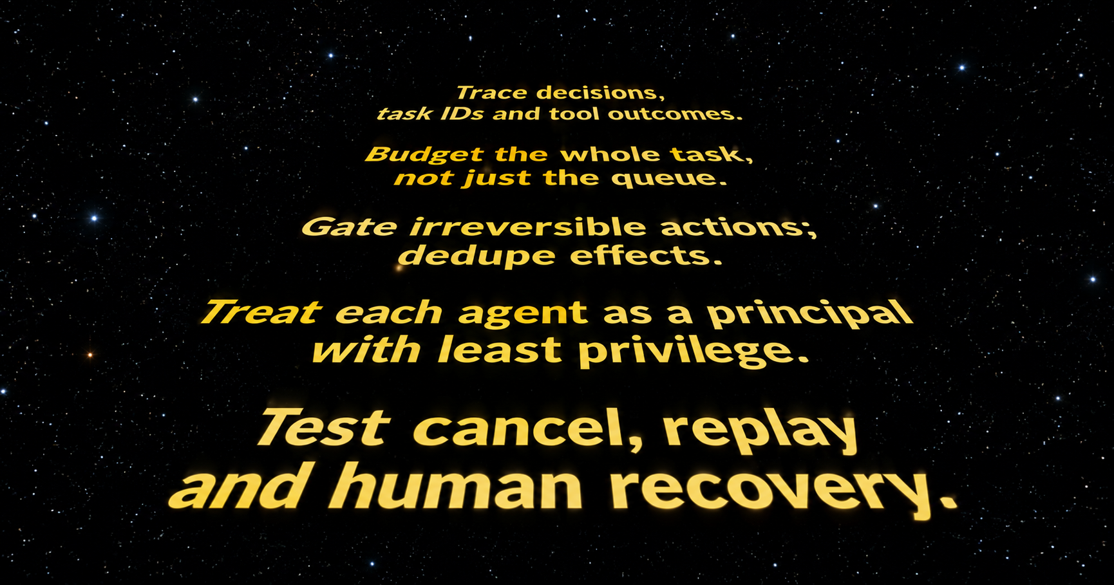

Slide 58
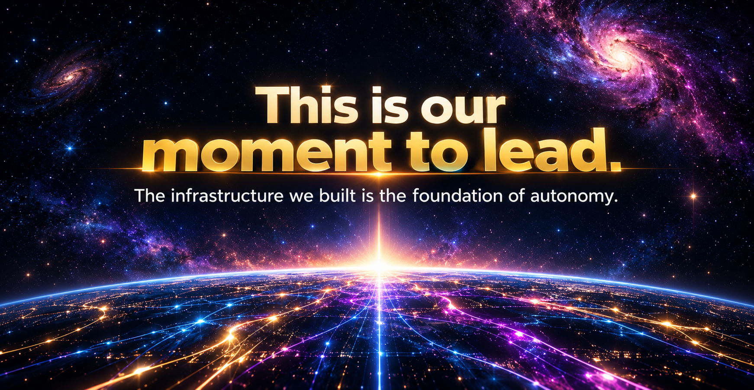

Slide 59
💡 Learn More!
https://www.anthropic.com/engineering/building-effective-agents
https://learn.microsoft.com/en-us/azure/architecture/ai-ml/guide/ai-agent-design-patterns
https://docs.aws.amazon.com/prescriptive-guidance/latest/agentic-ai-se
rverless/event-driven-architecture.html
https://learn.microsoft.com/en-us/azure/architecture/patterns/choreography
https://go.temporal.io/platform-hub/ai-engineering/ai-reference-architecture
https://docs.aws.amazon.com/prescriptive-guidance/latest/agentic-ai-patterns/prompt-chaining-saga-patterns.html
https://docs.aws.amazon.com/prescriptive-guidance/latest/agentic-ai-patterns/evaluator-reflect-refine-loop-patterns.html ;
https://docs.aws.amazon.com/prescriptive-guidance/latest/agentic-ai-patterns/observer-and-monitoring-agents.html
Notes:
SLIDE 54 · 48:00–48:30 · 0.5 min
SECTION: 26
Return to personal stakes. “I like writing code. I like the craft of building things that work despite imperfect networks and imperfect assumptions. The bot that helped with my upgrade was wonderful because the system produced a real result—not because it produced convincing words.” The infrastructure disappears when it works, and becomes everything when it fails. Hold the image for an emotional breath.
VISUAL VERSION — on-slide text moved off the image:
• WHY THIS WORK MATTERS
• This is still our craft,
• at a larger scale.
• Making imperfect systems produce dependable outcomes.
• Adi Polak
• 54

Slide 60



